Slide 1
Time Value of Money
Lecture 5: Computer Applications in Finance

Slide 2
MOVE Data
To move data, we shall use CUT and PASTE
Right click, cut
Right click, paste
Shortcut:
Ctr+X
Ctr+V

Slide 3
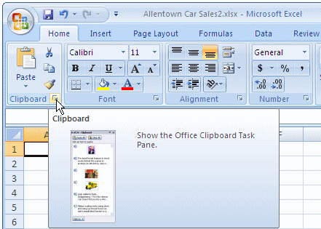
Clipboard
Clipboard can be used to copy and hold multiple items

Slide 4
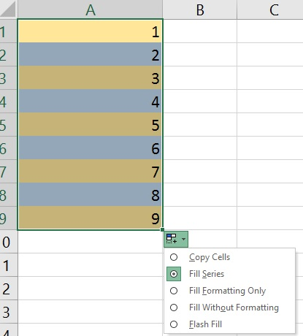
Fill Data Series
Select the first cell in the range that you want to fill.
Type the starting value for the series.
Type a value in the next cell to establish a pattern. ...
Select the cell or cells that contain the starting values.
Drag the fill handle across the range that you want to fill.

Slide 5
Number Formats
We can change display format of numbers from the Home > Number
Change 0.459 to % (45%)
Change 39000 to long date format, (Tuesday, October 10, 2006 )
Change 10000 to currency ($100,000)

Slide 6
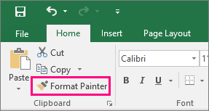
Format Painter
Select the shape, text, picture, or worksheet cell with the formatting you want to copy.
Click Home, and in the Clipboard group, click Format Painter.
After the pointer changes to a paintbrush, click and drag to select the shape, text, or worksheet cell that you want to format, and then release the mouse button.

Slide 7
Font
Home > Font
Can be used for:
Change font style
Font size
Font color
Alignment
Border
Fill
Protection

Slide 8
Conditional Formatting
Presets
Highlight Cells Rules
Top-Bottom Rule
Color Scales
Icon Sets

Slide 9
Conditional Formatting – New Rules
Format cells that contains
Format only top or bottom ranked values
Format only values that are above or below average
Format only unique or duplicate values
Use a formula to determine which cells to format
Assignment = Two Marks
Submit on the course website page

