Slide 1
MS Excel Environment and Functions
Computer Applications in Finance

Slide 2
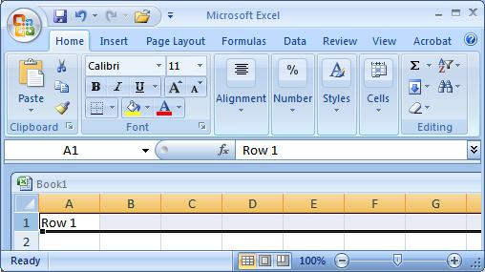
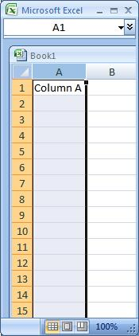
Excel Basics
Excel spreadsheets organize information (text and numbers) by rows and columns:
This is a row.
Rows are represented by numbers along the side of the sheet.
This is a column.
Columns are represented by letters across the top of the sheet.
Notes:
2

Slide 3
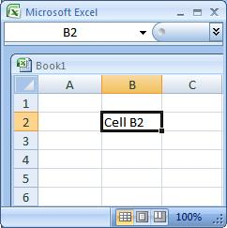
Excel Basics
A cell is the intersection between a column and a row.
Each cell is named for the column letter and row number that intersect to make it.

Slide 4
Add, delete columns and rows
Insert columns: right click on the column headers, i.e. letters A, B, etc, and click insert
Delete columns: right click on column headers, and click delete
Insert rows: right click on extreme left row headers, i.e. the numbers 1, 2, etc, and click insert
Delete rows: as above, click delete

Slide 5
Workbooks and Sheets
Workbook :
A workbook is an Excel file that contains one or more worksheets.
Worksheets:
An Excel worksheet is a single spreadsheet that contains cells organized by rows and columns.

Slide 6
Formulas and Functions
Formulas are equations that perform calculations in your spreadsheet. Formulas always begin with an equals sign (=). When you enter an equals sign into a cell, you are basically telling Excel to “calculate this.”
Functions are Excel-defined formulas. They take data you select and enter, perform calculations on them, and return value(s).

Slide 7
Examples of Functions

Slide 8
Cell References
Relative Reference
By default, Excel uses relative reference. These references change based on the relative position of rows and columns. For example, =A5, when copied one cell down, it becomes =A6
Absolute references
Absolute references do not change when copied to other cells. These references have $ sign

Slide 9
Relative Reference: Example
Enter the data in Excel sheet
Copy cell B2 to B3
Double click on B3
Do you see any change?

